Slide 1
Q-Rescue Quantum
Disaster Response Network
Team Name : Quantum Nexus
Quantathon 2K26,
Pragati University

Slide 2
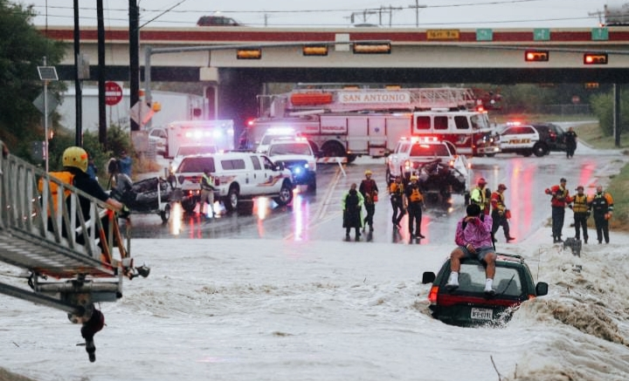
Problem Statement
The Problem Natural disasters cause delays in rescue operations.
Traffic and blocked roads slow emergency teams.
Resources are not always sent to the right place.
Every minute of delay can cost lives.

Slide 3
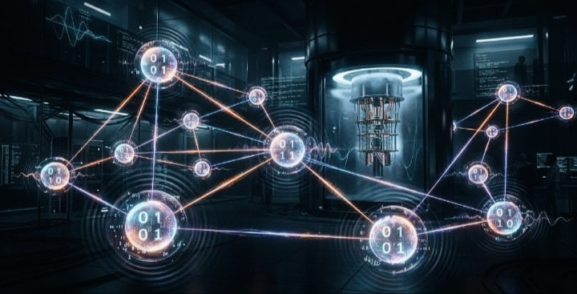
Our Solution
Our Idea Use Quantum Computing for faster decision-making.
Analyze multiple rescue routes at the same time.
Suggest the quickest and safest route.
Help distribute emergency resources efficiently.

Slide 4
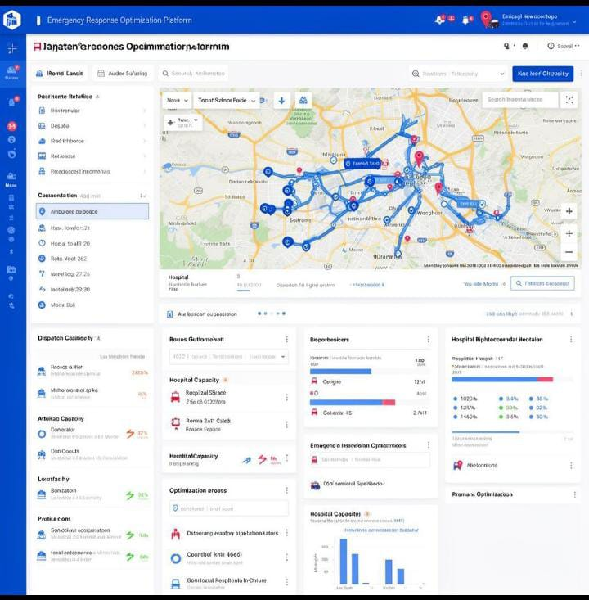
How It Works (Working Process)
Disaster information is collected.
The system receives emergency requests.
A Quantum Optimizer finds the best routes.
Rescue teams receive instant route suggestions.
Faster rescue operations save more lives.

Slide 5

Benefits
Faster rescue response.
Better resource allocation.
Reduced travel time.
Improved disaster management.
Future-ready smart emergency system.

Slide 6
Future Scope
Disaster Occurs
Flood/Cyclone
Best Route Found
Fastest & Safest
Smart Cities
NDRF & Disaster Management
Flood and Cyclone Response
Earthquake Emergency Planning
AI + Quantum integrated rescue systems
Data Collection
Sensors + Satellite
Rescue Team Alert
Resources Sent
Quantum Optimizer
Analyzes Routes
Lived Saved
Faster Response
Thank You
Presented By:-
Satya | Pramila | Nandini

